Slide 1
Hybrid Cloud

Slide 2
Public
In the Public Cloud space, Windows Azure, Amazon Cloud Services and Rackspace are big players. Amazon elastic compute cloud (EC2) for example, provides the infrastructure and services over the public internet and are hosted at the cloud vendor’s premises. The general public, SMEs or large enterprise groups can leverage this cloud model. Here the infrastructure is owned by the company that provides the cloud services. In a public cloud, the infrastructure and services are provisioned from a remote location hosted at the cloud provider’s datacenter and the customer has no control and limited visibility over where the service is hosted. But they can use those services anytime anywhere as needed. In the Public Cloud, the core computing infrastructure is shared among several organizations. That said, each organization’s data, applications, and infrastructure are separated and can only be accessed by the authorized personnel.

Slide 3
Public Provides
Provides the infrastructure and services over the public internet and are hosted at the cloud vendor’s premises
Infrastructure - The core computing infrastructure is shared among several organizations
Access - Each organization’s data, applications, and infrastructure are separated and can only be accessed by the authorized personnel.
Services and Provisioned - the infrastructure and services are provisioned from a remote location hosted at the cloud provider’s datacenter and the customer has no control and limited visibility over where the service is hosted. But they can use those services anytime anywhere as needed
Business Groups – (General public, SMEs or large enterprise groups can leverage this cloud model)

Slide 4
Choose Public Cloud
The Public Cloud offers advantages such as low cost of ownership, automated deployments, scalability and also reliability.
The Public Cloud is well suited for the following:
Data storage
Data Archival
Application Hosting
Latency intolerant or mission critical web tiers
On demand hosting for microsite and application.
Auto-scaling environment for large applications.

Slide 5
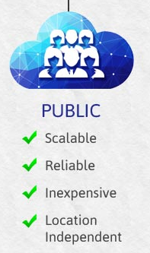
Advantage of Public Cloud Computing
It offers greater scalability
Its cost effectiveness helps you save money.
It offers reliability which means no single point of failure will interrupt your service.
Services like SaaS, (Paas), (Iaas) are easily available on Public Cloud platform as it can be accessed from anywhere through any Internet enabled devices.
It is location independent – the services are available wherever the client is located.

Slide 6
Disadvantage of Public Cloud Computing
No control over privacy or security
Cannot be used for use of sensitive applications
Lacks complete flexibility as the platform depends on the platform provider
No stringent protocols regarding data management

Slide 7
Private
A Private Cloud, as the name suggests, is a cloud infrastructure that is meant for use exclusively by a single organization. The cloud is then owned, managed and operated exclusively by the organization or by a third-party vendor or both together. In this cloud model, the infrastructure is provisioned on the organization premise but may be hosted in a third-party data center. However, in most cases a Private Cloud infrastructure is implemented and hosted in an on-premise data center using a virtualization layer.
While the Private Cloud offers the greatest level of control and security, it does demand that the organization purchase and maintain all the infrastructure and acquire and retain the skill to do so. This makes the Private Cloud significantly more expensive and a not-so-viable option for small or mid-sized organizations.

Slide 8
Private
Owned by Single Organization
Cloud owned, managed and operated exclusively by the organization or by a third-party vendor or both together
Infrastructure - provisioned on the organization premise but may be hosted in a third-party data center.
In most cases a Private Cloud infrastructure is implemented and hosted in an on-premise data center using a virtualization layer.
Private Cloud offers the greatest level of control and security
Private Cloud significantly more expensive and a not-so-viable option for small or mid-sized organizations.

Slide 9
Choosing Private Cloud
Choosing a Private Cloud makes sense for:
Running a private cloud in your datacenter while also leveraging public cloud services like Amazon Web Services or Microsoft Azure
A private cloud application that integrates an external data feed like meteorlogical or mapping data from a public source
Organization that demand strict security, latency, regulatory and data privacy levels.
Organizations that are highly regulated and need data hosted privately and securely.
Organizations that are large enough to support the costs that go into running a next-gen cloud data center.
Organizations that need high-performance access to a filesystem such as in media companies.
Hosting applications that have predictable usage patterns and demand low storage costs.
Organizations that demand greater adaptability, configurability, and flexibility.
Hosting business critical data and applications.

Slide 10
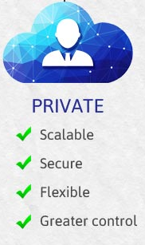
Advantages of Private Cloud
Offers greater Security and Privacy
Offers more control over system configuration as per the company’s need
Greater reliability when it comes to performance
Enhances the quality of service offered by the clients
Saves money

Slide 11
Disadvantage of Private Cloud
Expensive when compared to public cloud
Requires IT Expertise

Slide 12
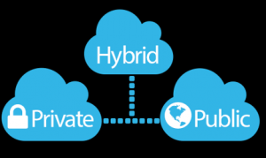
So, what does an organization do when it wants to leverage the cloud both for its efficiency and cost saving but also wants security, privacy, and control?
Move to Hybrid

Slide 13
Hybrid Cloud
So, what does an organization do when it wants to leverage the cloud both for its efficiency and cost saving but also wants security, privacy, and control? It looks at the Hybrid Cloud which almost serves as a mid-way point between Public and Private Cloud. The Hybrid Cloud uses a combination of at least one Private and one Public Cloud. The Private Cloud can be on-premise or even a virtual private cloud located outside the organization’s data center. A Hybrid Cloud can also consist of multiple Private and Public Clouds and may use many active servers, physical or virtualized, which are not a part of the Private Cloud. With the Hybrid Cloud, organizations can keep each business aspect in the most efficient cloud format possible. However, with the Hybrid Cloud, organizations have to manage multiple security platforms and aspects and also ensure that all the cloud properties can communicate seamlessly with one another.

Slide 14
Hybrid Cloud (short def)
Hybrid Cloud which almost serves as a mid-way point between Public and Private Cloud
The Hybrid Cloud uses a combination of at least one Private and one Public Cloud. The Private Cloud can be on-premise or even a virtual private cloud located outside the organization’s data center
A Hybrid Cloud can also consist of multiple Private and Public Clouds and may use many active servers, physical or virtualized, which are not a part of the Private Cloud.
organizations have to manage multiple security platforms and aspects and also ensure that all the cloud properties can communicate seamlessly with one another.

Slide 15
A Hybrid Cloud is best suited for:
Large organizations that want the flexibility and scalability as offered by the public cloud.
Organizations that offer services for vertical markets- customer interactions can be hosted in the Public Cloud while company data can be hosted in the Private Cloud.
Organizations that demand greater operational flexibility and scalability. For them, mission critical data can be hosted on the Private Cloud and application development and testing can take place in the Public Cloud.

Slide 16
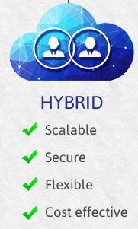
Advantage of Hybrid Cloud Computing
Advantage of Hybrid Cloud Computing
It is scalable
It is cost efficient
Offers better security
Offers greater flexibility

Slide 17
Disadvantage of Hybrid Cloud Computing
Infrastructure Dependency
Possibility of security breach through public cloud

Slide 18
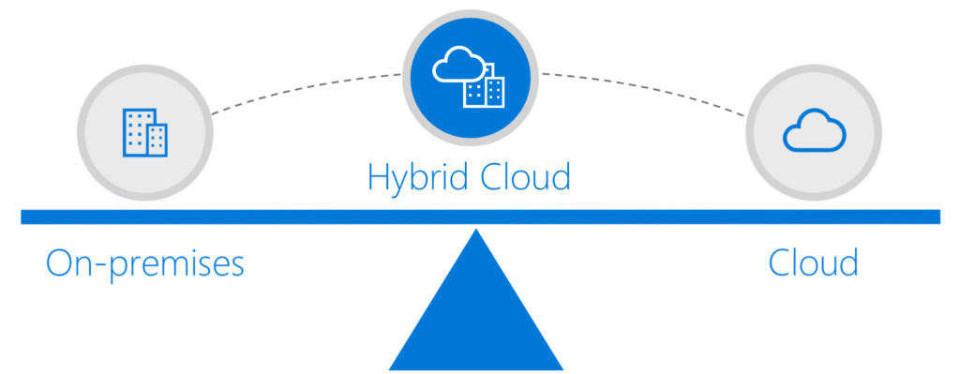
Where is On-premise sits ?

Slide 19
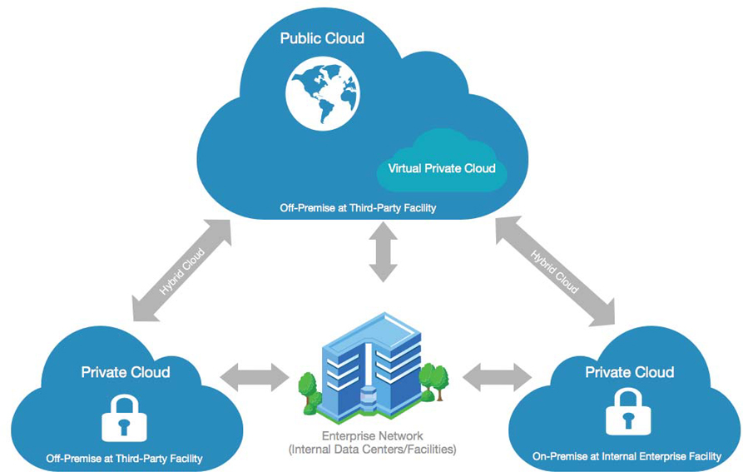
Hybrid Cloud Supports both On-premise/Off-premise

Slide 20
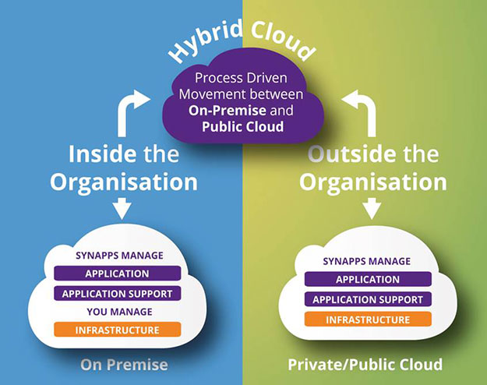
Different View

Slide 21
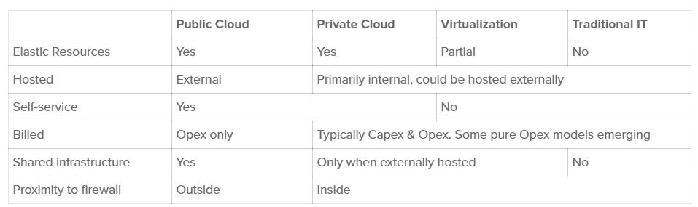
More Details
Clouds differ from virtualization and traditional IT infrastructures in the following ways:

Slide 22
Lets discuss the real problem ?

Slide 23
The Situation You Face
In order to create a single data movement fabric that allows you to deploy applications in any cloud, you need to cover three types of connectivity:
Messaging within each cloud – between distributed applications or microservices in each target cloud
Hybrid Cloud data movement – between your existing on-premise apps and your new cloud apps
Cloud-to-cloud data movement – so applications running in different clouds can share information

Slide 24
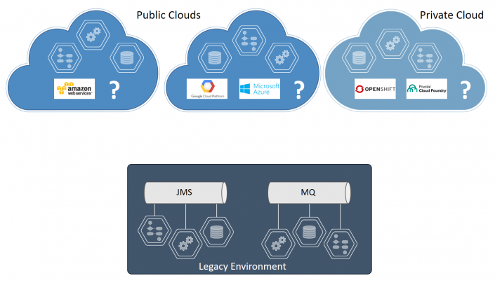

Slide 25
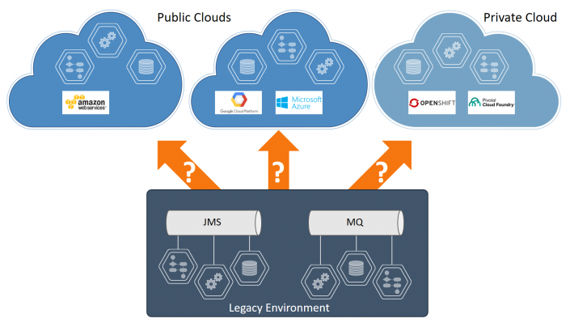
Legacy to Cloud – Hybrid Cloud

Slide 26
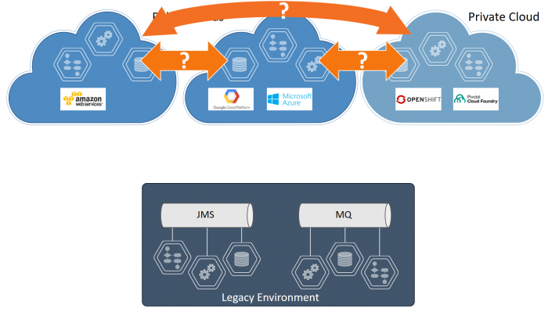
Cloud to Cloud

Slide 27
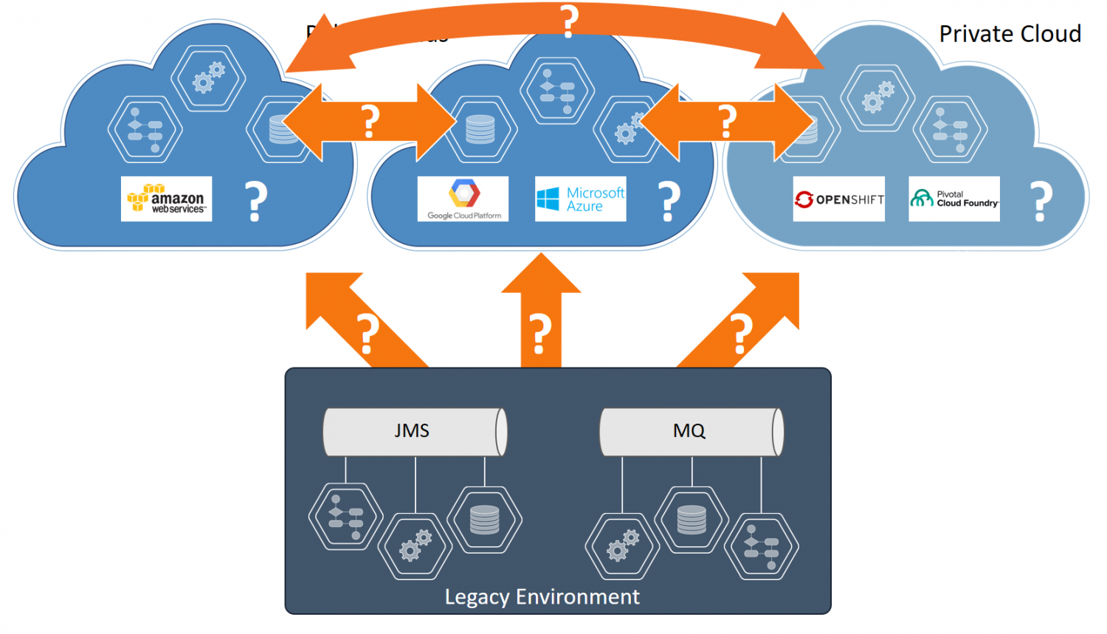
Full View

Slide 28
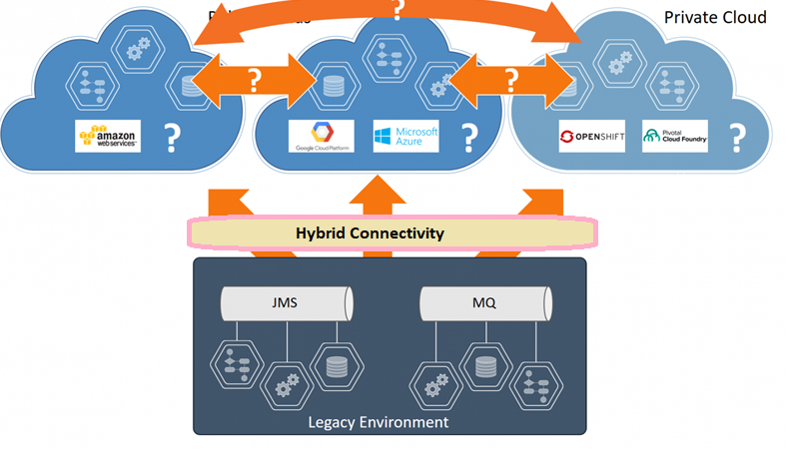

Slide 29
Hybrid Connectivity in Tibco Cloud Integration (iPass)
Hybrid connectivity refers to the ability to connect Apps hosted in TIBCO Cloud™ Integration to services running on-premise in your network using a virtual private network (VPN). To accomplish this, you can configure a VPN client within TIBCO® Cloud Integration to connect to a VPN server within your network.
Hybrid Connectivity enables you to access databases or services hosted on your networks from a TIBCO BusinessWorks™ App or Node.js App running in the cloud. Your on-premise services such as JDBC, FTP, JMS, and so on could then be used by Apps. It does not require exposing your database or service as a public Internet service, so there are no open ports on your side.
Hybrid connectivity supports Cisco AnyConnect SSL VPNs (using the Cisco AnyConnect protocol) and Juniper SSL VPNs (using the Juniper Network Connect protocol.)
A VPN connection defines the connectivity settings and credentials required to enable a VPN connection to your on-premise VPN server. After creating a connection, you can then attach it to an App, and the App can connect to on-premise TCP services with the VPN.

Slide 30
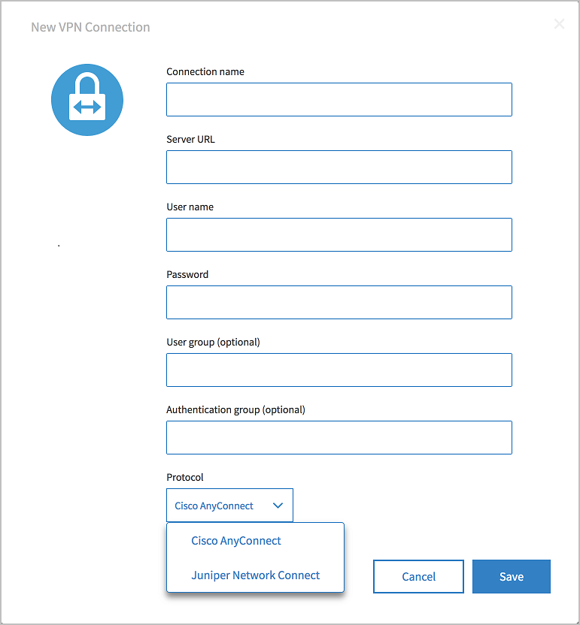
Creating a VPN Connection
Properties | Description
Connection name | The name of the VPN connection.
Server URL | The URL for your on-premise VPN server.
User name | The username to log in to your VPN server.
Password | The password to log in to your VPN server.
User group (optional) | An optional user group for your VPN login.
Authentication group (optional) | An optional authentication group for your VPN.
Protocol | The VPN protocol, either Cisco AnyConnect or Juniper Network Connect

Slide 31
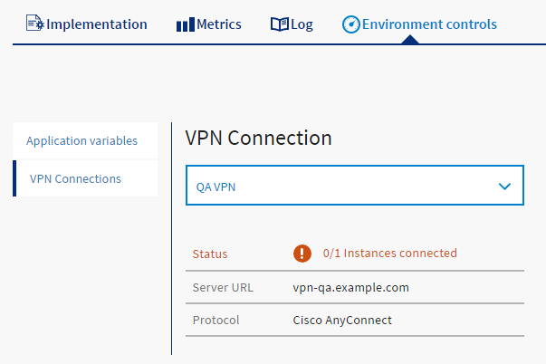
Using a VPN in an App
To use hybrid connectivity, you must add a VPN connection to your App. This can be done in one of two ways:
Add the VPN connection to your App in TIBCO Business Studio™ for BusinessWorks™. This sets the VPN in the App manifest. When you push the app (from TIBCO Business Studio for BusinessWorks, or using the TIBCO Cloud - Command Line Interface (CLI), or from the Web interface) it will use the VPN connection defined in the manifest.
Attach a connection to an existing TIBCO BusinessWorks™ App or Node.js App on the App Details page.

Slide 32
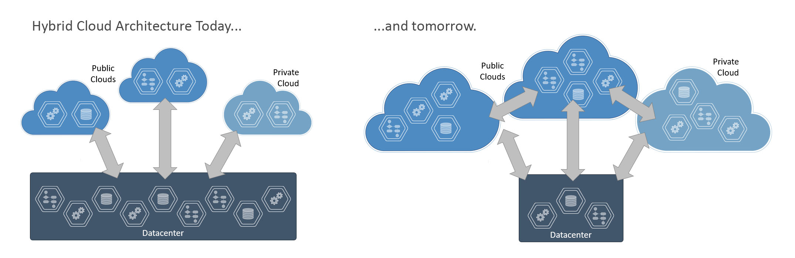
Current and Future State

Slide 33
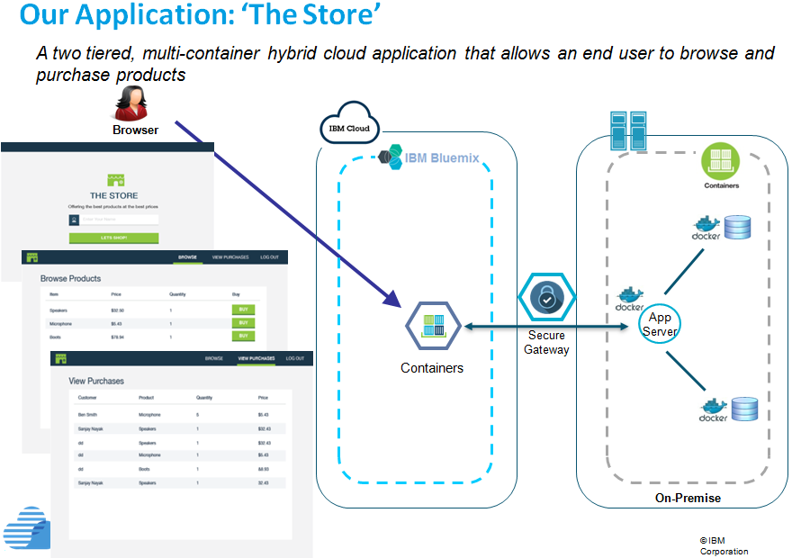
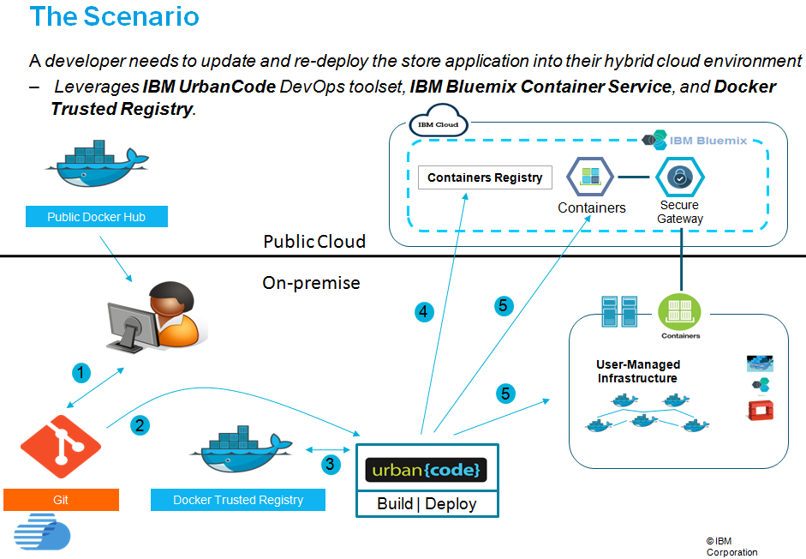
Come to PaSS

Slide 34
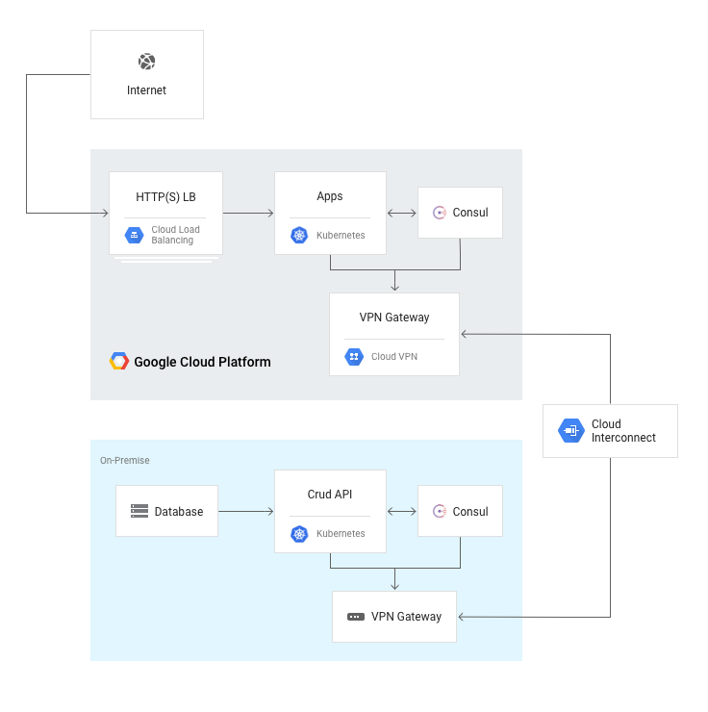
One more Example

Slide 35
Refrence
https://12factor.net/

Slide 36
https://prod-publicportal.cloudthis.com/products/tibco-hybrid-integration-1-5-0

